Slide 1
In which GICS sector, average revenue growth is more stable between 2012-2016?
I want to see which sector is more save in its average revenue growth. after I put the data in a chart, I saw that except for Financials, Real Estate and Energy (the dotted line)in every other sector, average revenue growth in 2016 was positive.

Slide 2
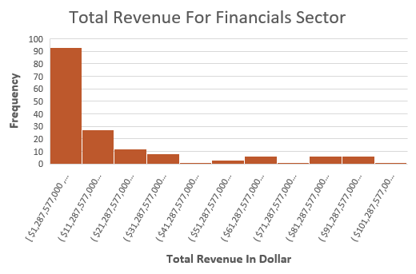
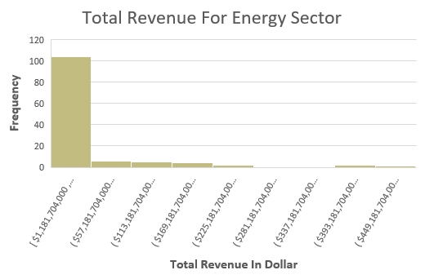
Does The Financial Sector Have A Similar Total Revenue Level As The Energy Level?
Here are the histograms for total revenue in the Financial and Energy sectors.
Both distributions are right-skewed (the mean is higher than the median).
The mean in Financials is about 20.8B and un the Energy is about 38.9B, in the median, The difference is smaller
10.3B for Financials and 11.7 for Energy.
The difference in the mean is because the Energy sector has a higher standard deviation and range (79.8B, 450.3B) than the financial sector (26.4B, 100.4B).

